Slide 1
NucWik – Sharing Teaching Material for Nuclear Science
Jon Petter Omtvedt and Hans V. Lerum
Univ. Oslo and the CINCH collaboration
RadChem’2014 in Marianske Lazne

Slide 2
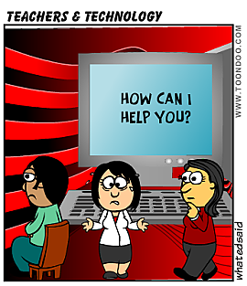
E-teaching – do you do it?
Webcasting, podcasting, whatever-casting..
Facebook, Twitter, SMS, .., “Social media”
E-learning platforms
Blogs and web-pages
On-line resources
Computers in Science
WEB 2.0
... and Wikis

Slide 3
This talk..
There is a lot of exciting e-learning tools available.
This is not about any of them!

Slide 4
NucWik
The basic idea
Most of us do not have the time, energy, knowledge, etc. to make ”fancy teaching stuff” ...
... we don’t even have time to make the normal stuff!
There is a lot of teaching material around, but most of it are not openly available or are even “protected” and/or hidden.
Why not share it?

Slide 5
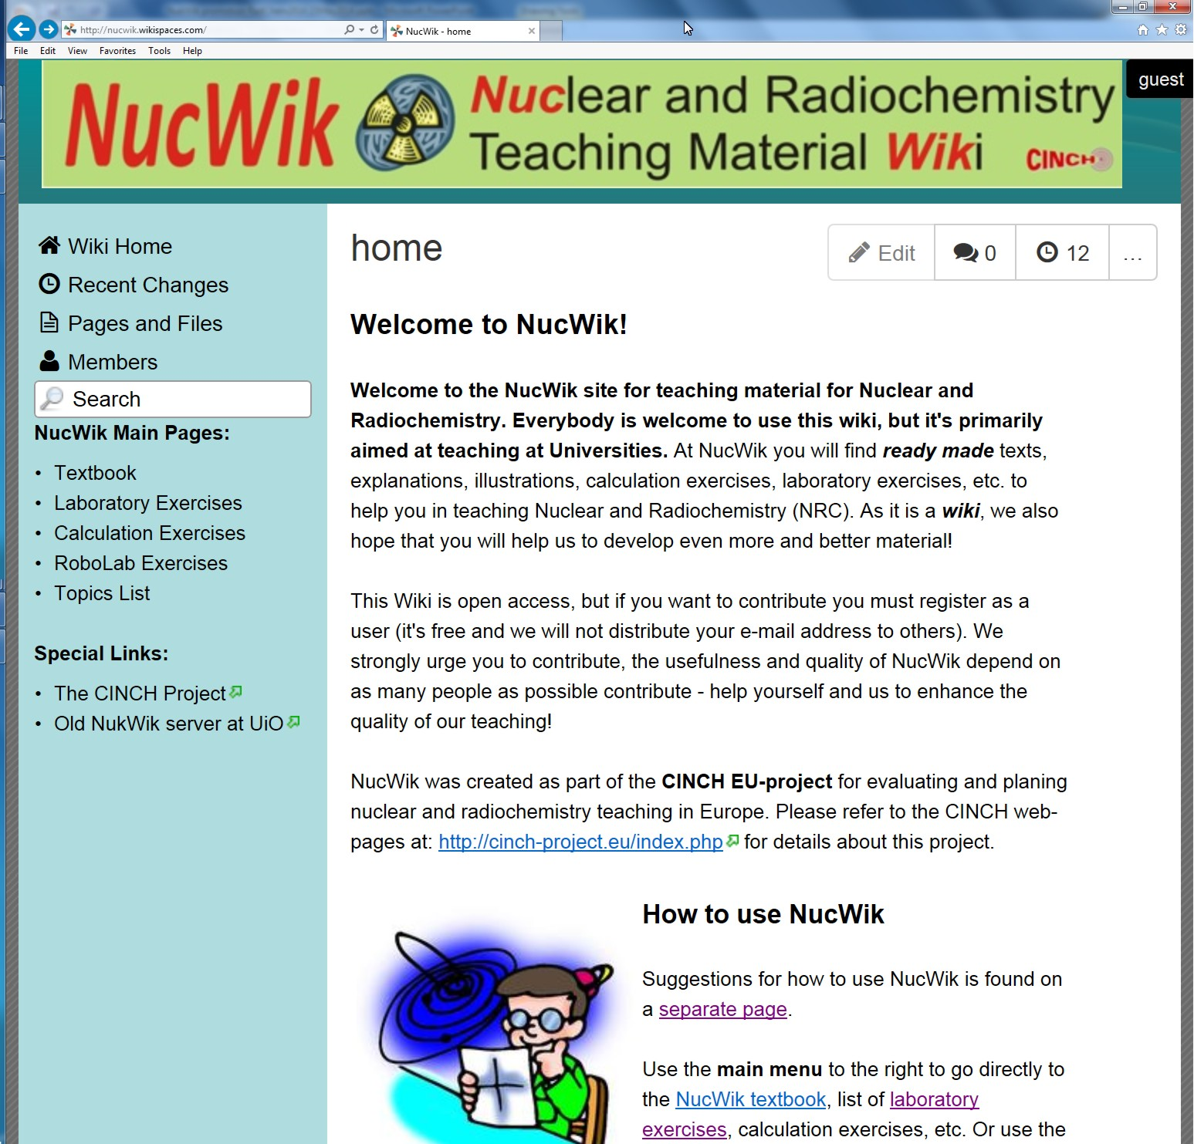
Site for sharing Teaching Material
http://nucwik.wikispaces.com/

Slide 6
Some Facts about Wikis
A Wiki is a tool for joint document development and sharing.
The most well known example is Wikipedia.
The quality of a Wiki largely depend on active users.
About NucWik:
Developed as part of the FP7 CINCH project.
Runs on the commercial WikiSpaces server.
http://nucwik.wikispaces.com/

Slide 7
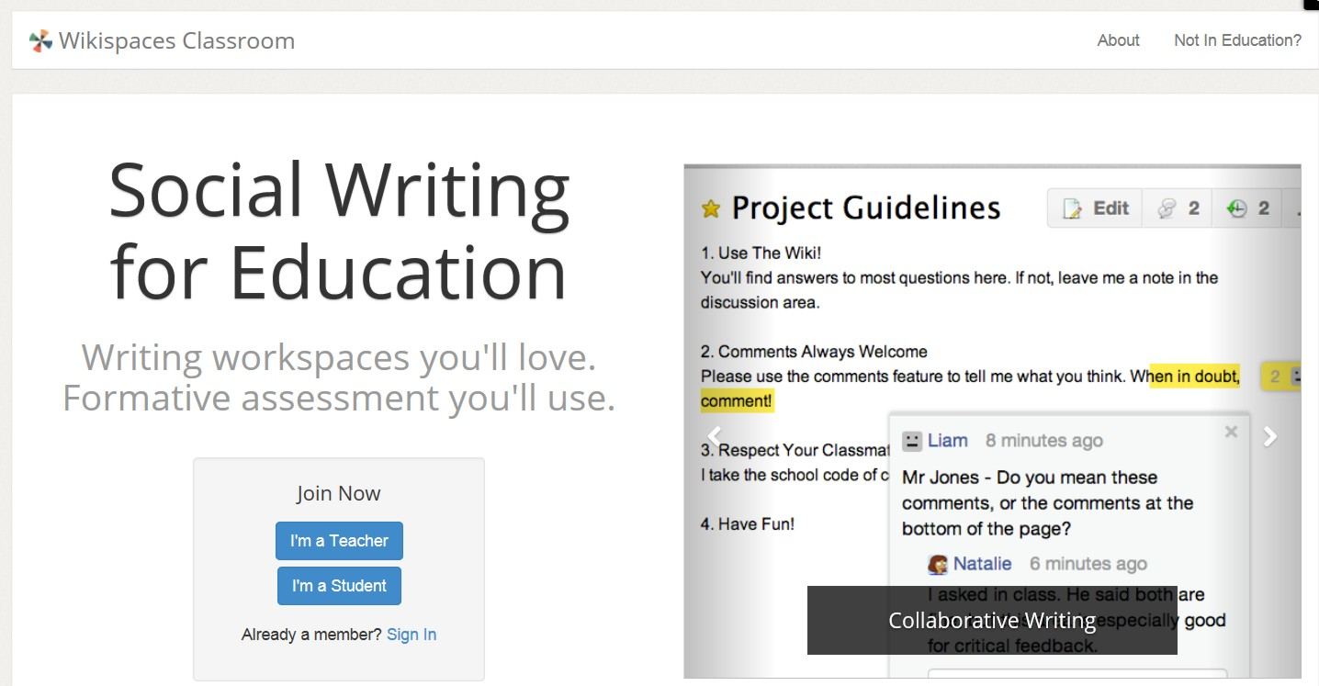
www.wikispaces.com

Slide 8
Site for sharing Teaching Material
NukWik:
No reading or downloading restrictions.
Must register to upload material or edit content.
It’s free!

Slide 9
NucWik – Main Menu

Slide 10
NucWik – Main Menu

Slide 11
Understand this..
NucWik is not a ready made, polished product in its final form.
It is primarily a tool for active collaboration between teachers.
You want it better? Then make it so!
It can be used in many ways, most likely in ways not initially planned for.
It’s up to you!

Slide 12
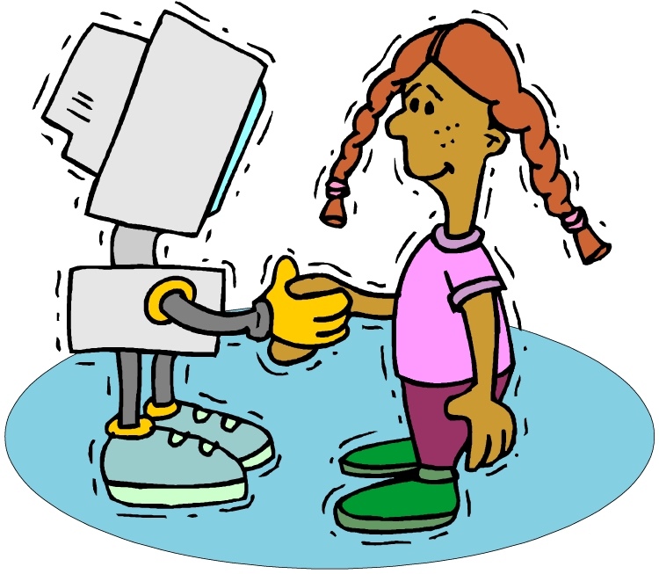
Do you want to use it?
We can help you get started!
By visiting and help you to “learn the ropes”.
We will make on-line courses.
Arrange dedicated courses (planed for Helsinki in 2015)

Slide 13
Quality Control
A “peer review” system will be implemented.
“CINCH Approved” guaranties that a document has been review by other teachers, approved by CINCH.
Documents will be clearly labeled.
APPROVED

Slide 14
Can everybody edit?
You must be a registered user to create and edit documents.
However, everybody can comment on a document, e.g. in order to:
report errors
suggest improvements
communicate to others how it was used
or simply just say thank you!
If you do not want to upload yourself, we will much appreciate material we can upload!

Slide 15
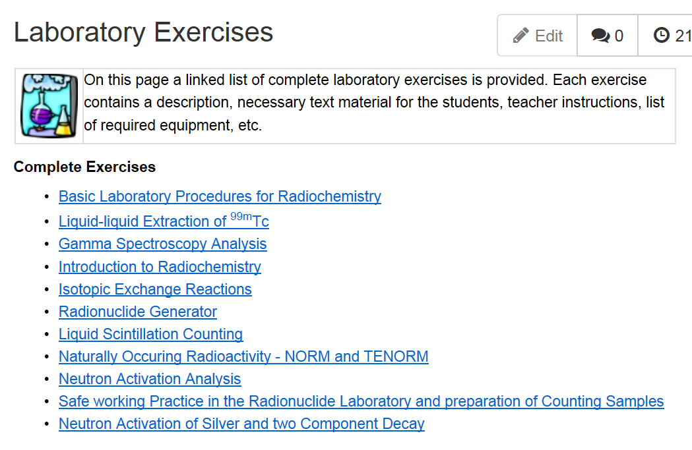
NukWik teaching material (I)

Slide 16
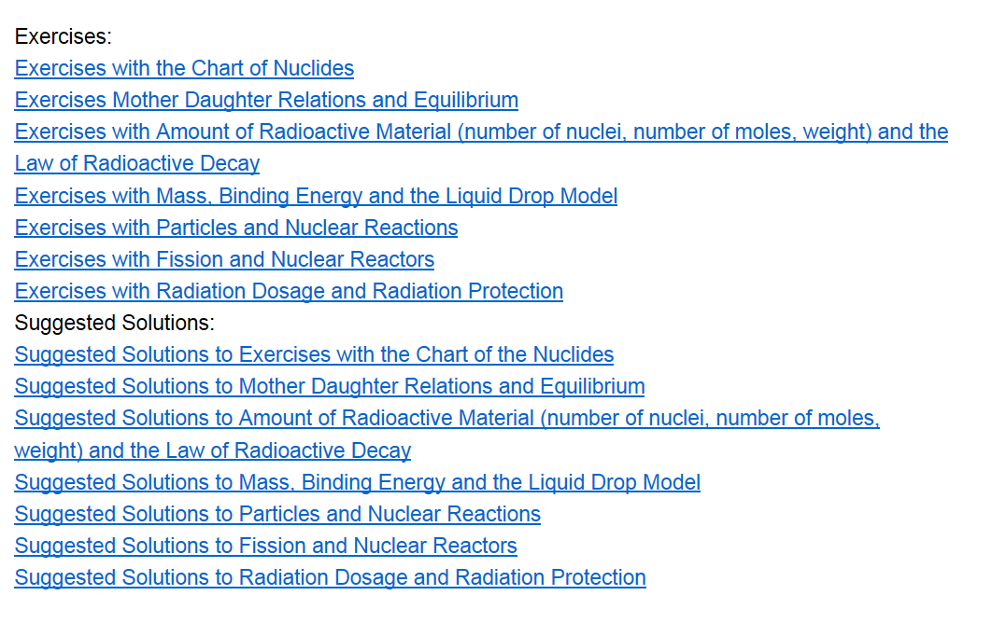
NukWik teaching material (II)

Slide 17
RoboLab

Slide 18
RoboLab

Slide 19
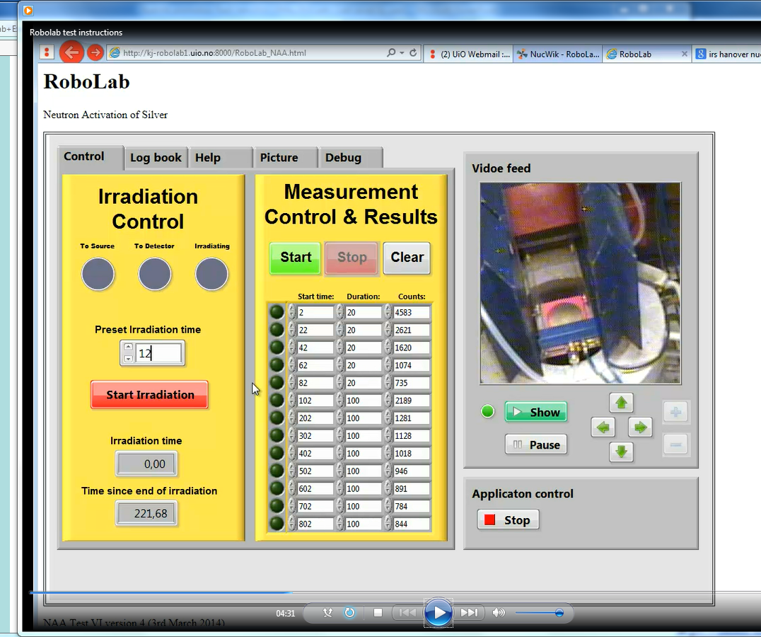
RoboLab
Instruction video

Slide 20
Conclusions
We can do better teaching if we..
.. share our teaching material
.. use modern technology
.. work together
.. inspire each other
.. learn from each other
NucWik demonstrates one way of
achievin this using “modern” tools.

Slide 21
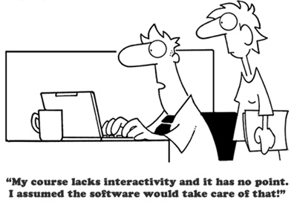
That’s all folks – thank you!

Slide 22
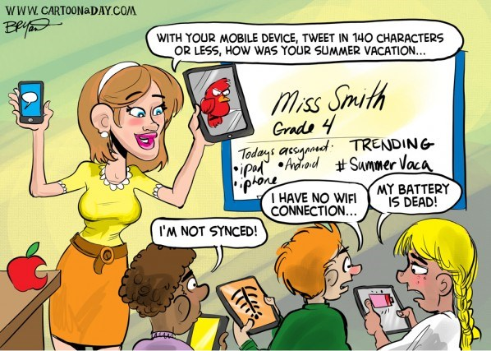
E-teaching aids – can you manage without?

Slide 23
What We Want...
Basically, we want to provide the best teaching ever given - all the time!

