Slide 1
How to use NukWic
Tips and tricks
by Lans V. Lerum
Oslo, 25th August 2014
Notes:
I personaly think that the best way to learn a wiki is to just sit down and actualy make an article. However I will try to give you a short cut, so you hopefully wont make all the mistakes i did, but rather invent new ones.

Slide 2
In this Powerpoint file
Tips and Tricks
How to Upload
Figures
Text
Using Projects
Tags
How to make a Template
Notes:
So I will presnets some tips andtricks for quickly writing up some articles. As I suspect taht most of what will be put up is things taht has already been written. It is old material so to speak. So this is what the the two first segments will be about.
I will discuss projects which are usefull if several people works togheters. And i suggest that this is what we use today, we will talk more about that when we come to it.
I have rather large segment about templates. This is a recepie and i will not go trough it during this presentation.
Tags are usefull and will be discussed.

Slide 3
Setting up Your Page
Mark and Click
Change to wiki text
Title is given from the link to the page
Notes:
Making a page is easy. There are several ways, one is to clik the new page button the other is to write a name and then create a link. This will have to be done trough the edit page.
Wiki text is usefull if you are coping text. If you copy from wikitext to wikitext or from UTF8 coded text to wikitext you will get exactly what you copy. If you copy directly from programs such as word or adobe strange things will happen to your text.
The title can be changed and pages can be deleted, this is actualy not that common in wikisystem and it is a good thing. We do not need to wory about having permanent mistakes.

Slide 4
Tags
Are a way to classify your pages
Pages can have several tags
All files can also have tags
Tags can be used as search words
A way to keep track of finished pages.

Slide 5
Tags
Notes:
Enter pages and files mark one of the files.- You will now have the option to mark edit tags. This way several simmilar pages can be given an tag. Say if you have made 10 or so new pages which belong toghter.

Slide 6
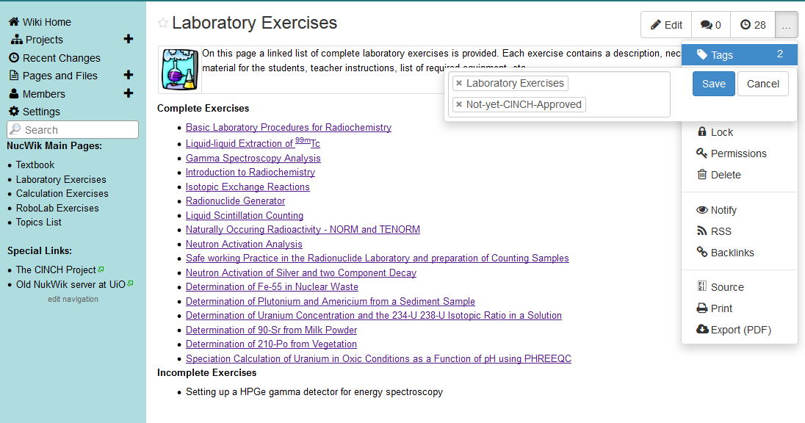
Tags
Notes:
The other way to make tags is to do it on the page you are already editing. Press the more options button. At the top you will get the optin of tags. Press this button then edit then this menu should appare. as is visible the needed tags are already added to this site. But if you have more usefull tags they can be written in the field next to the other tags.

Slide 7
Projects
Projects are good cooperation between multiple people
Define different task for different people
Not visible for everyone before the participants choose too
Templates can be made in projects
Notes:
I have not had a chance to use project so much as i have been working alone. The yare howver the only way to make tmplates and are therfore very usefull if you are going to upload several things.
It would be very usefull tool for such a thing at the nucwiki text book as we wuould be able to write the theory on the page, and we would no need o vory about it beeing visible before it is reacdy. We could then also eddit and comment and chagne the text as it goes unti we are happpy with it. We would also be able to kkep al the older version and see who has edited what. In addition if the textbook is written directly into the nucwiki we would not need the extra workj of uploading the text and check the typsetting.

Slide 8
How to make a Template
Chose where you want to make your template
Notes:
If you must choose which projcet to make the template inn.

Slide 9
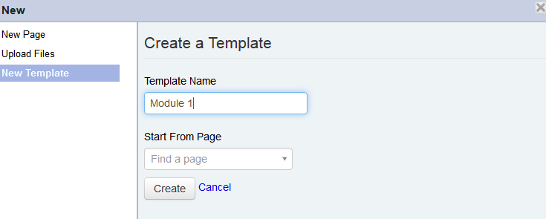
How to make a Template
Notes:
Then press the button new pages and you will get this menu

Slide 10
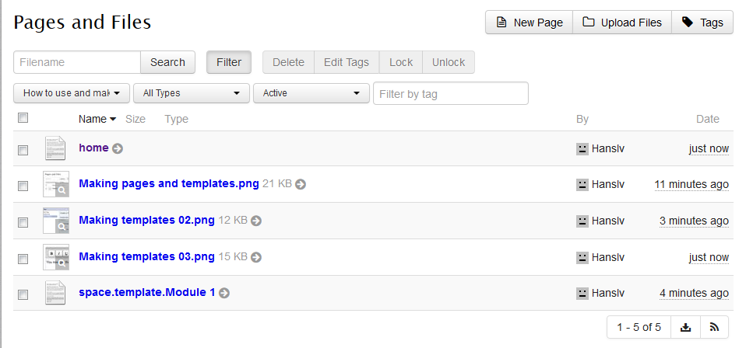
How to Make a template
Notes:
So we make a really small template at first. This template then shows up under menu of our project.

Slide 11
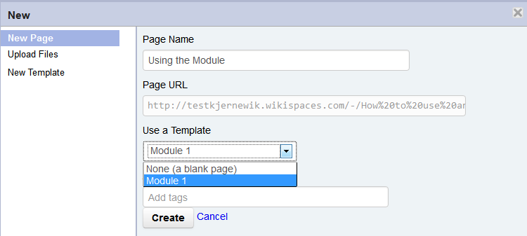
How to make A Template
Notes:
Now when you want to make a new page you get the option to use a template. I have cheated a bit and made bit more interesting template that hopefully some of you will recognice.

Slide 12
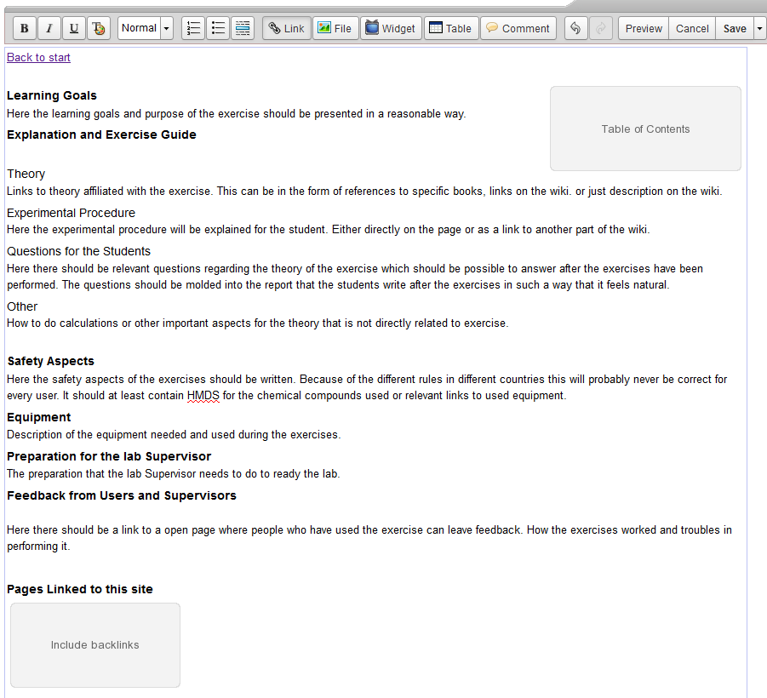
The Template
Notes:
This is the template I have used for the laboraory assignemets that have been sent to my. I have tried to make it orderly and usefull for both studentds and teachers. What has been clear is that teaching experiens is very hand to mouth and not something that is written down . We need pictures and descirptions on how to prepare for the different laboratory experiments. Otherwise I suspect the people who will want to use the site is small.

Slide 13
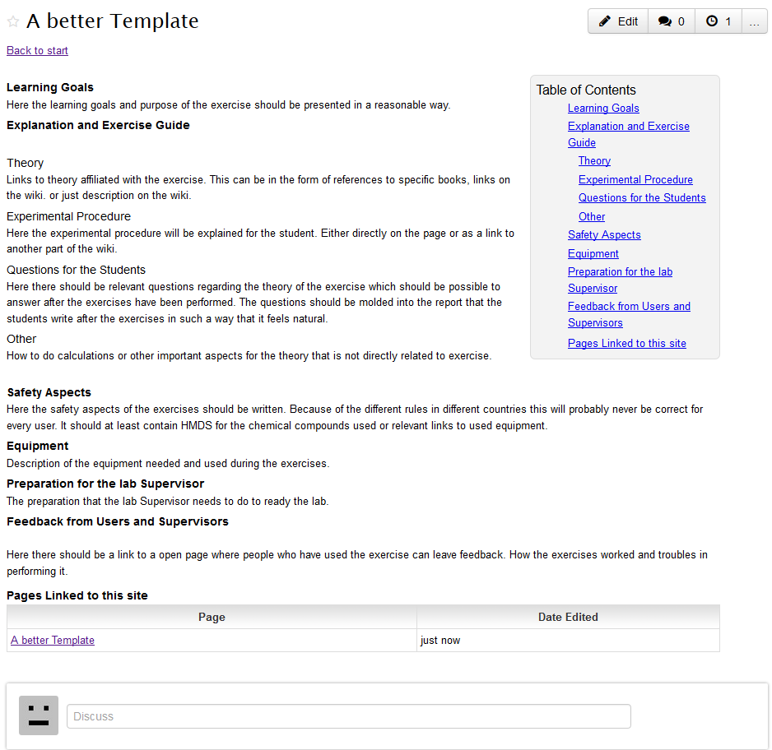
Notes:
This is what the template looks like before any work has been done.

